Slide 1
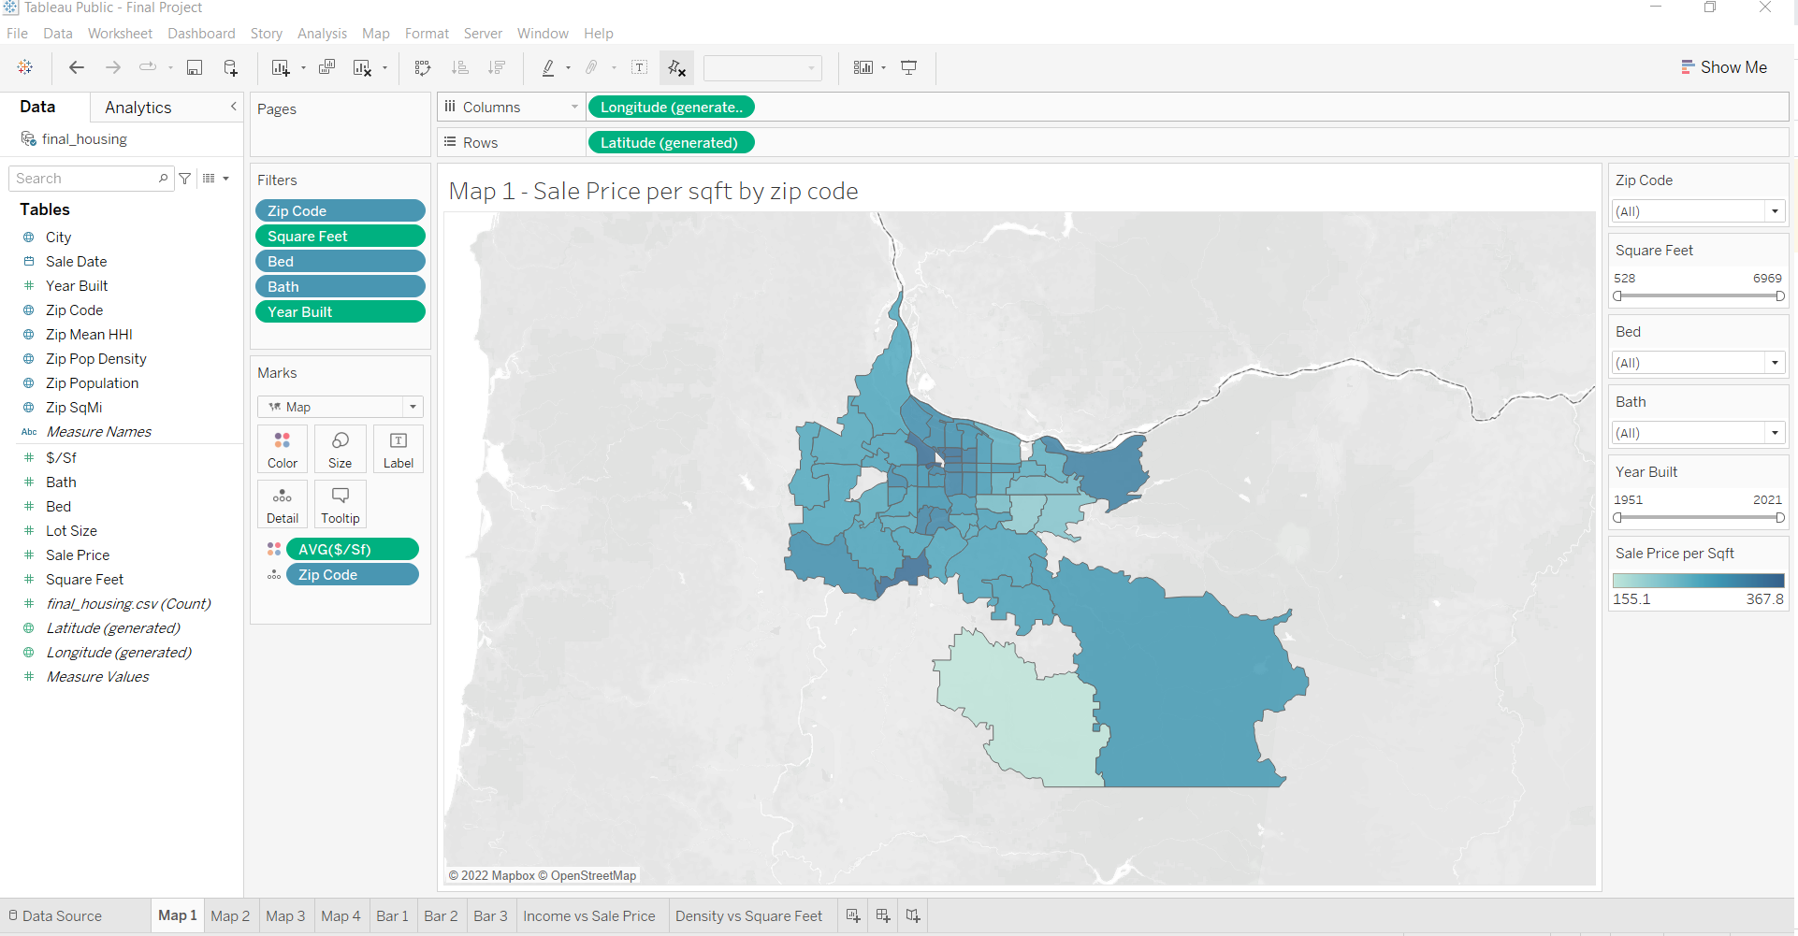
Data Bootcamp Final Project
Portland Real Estate
by
Christopher Snead
Kim Collins
Sebastian Vila

Slide 2
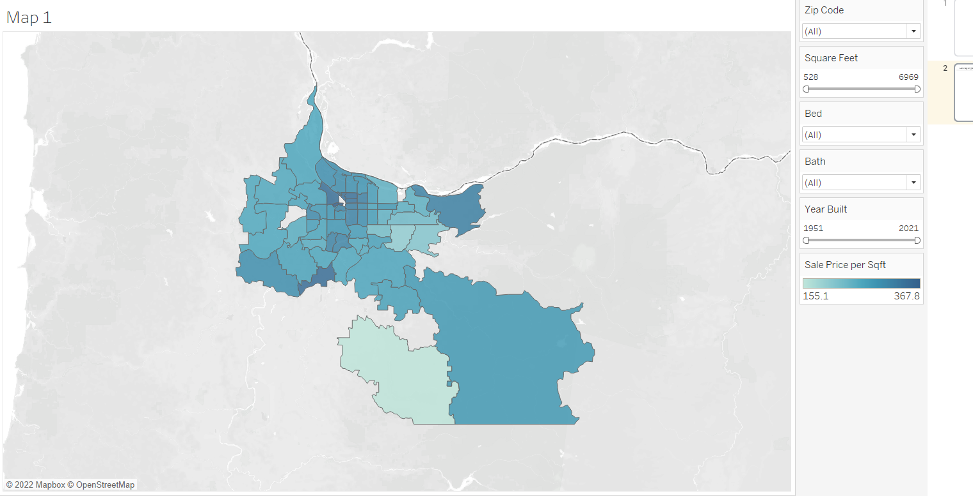
Sale Price per sqft by zip code interactive map
This map allows you to see Sale prices per sqft of homes in Portland by zip code. In the tableau version can be filtered by zip code, square feet, bed, bath and year built.

Slide 3
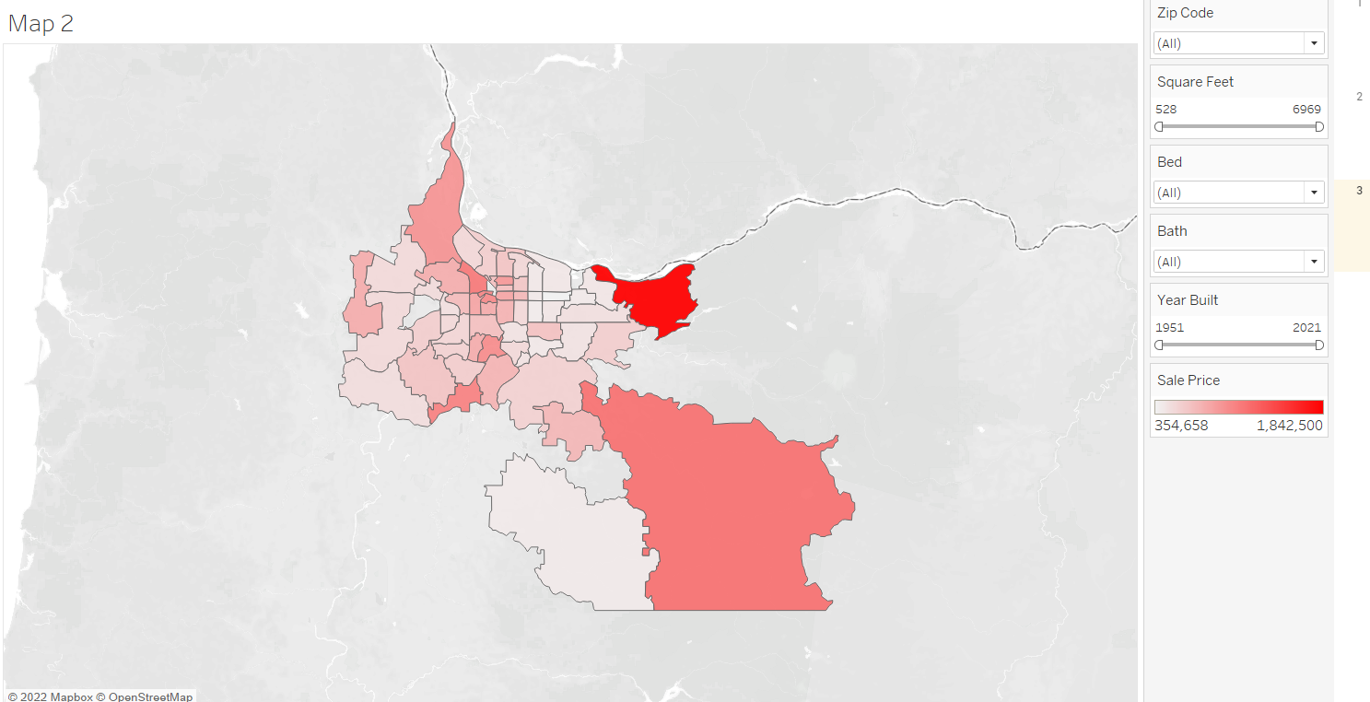
Sale Price by zip code interactive map
This map allows you to see Sale prices of homes in Portland by zip code. In the tableau version can be filtered by zip code, square feet, bed, bath and year built.

Slide 4
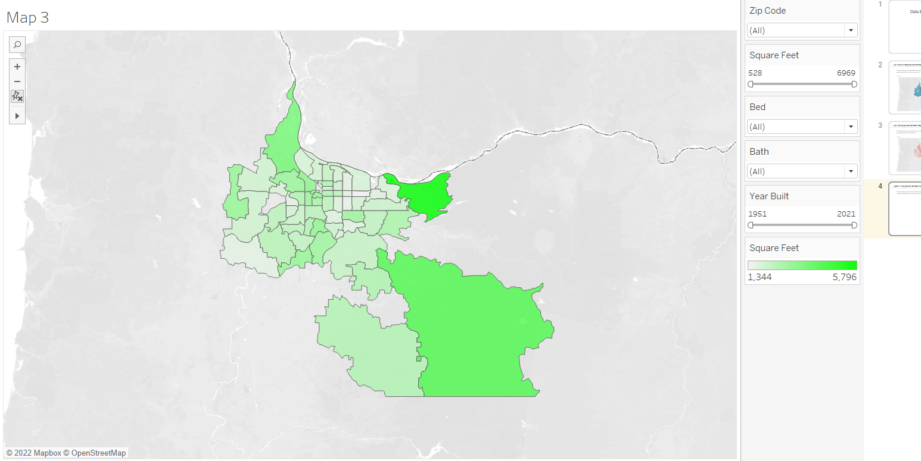
Square Feet by zip code interactive map
This map allows you to see Square feet from sold homes in Portland by zip code. In the tableau version can be filtered by zip code, square feet, bed, bath and year built.

Slide 5
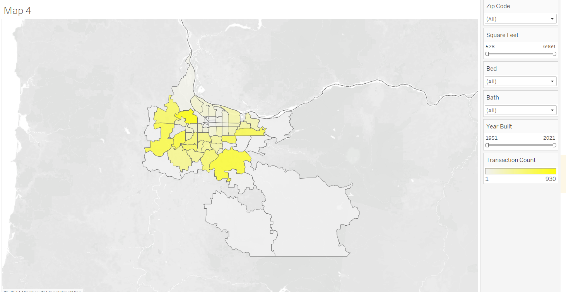
Count of transactions by zip code interactive map
This map allows you to see count of sold homes in Portland by zip code. In the tableau version can be filtered by zip code, square feet, bed, bath and year built.

Slide 6
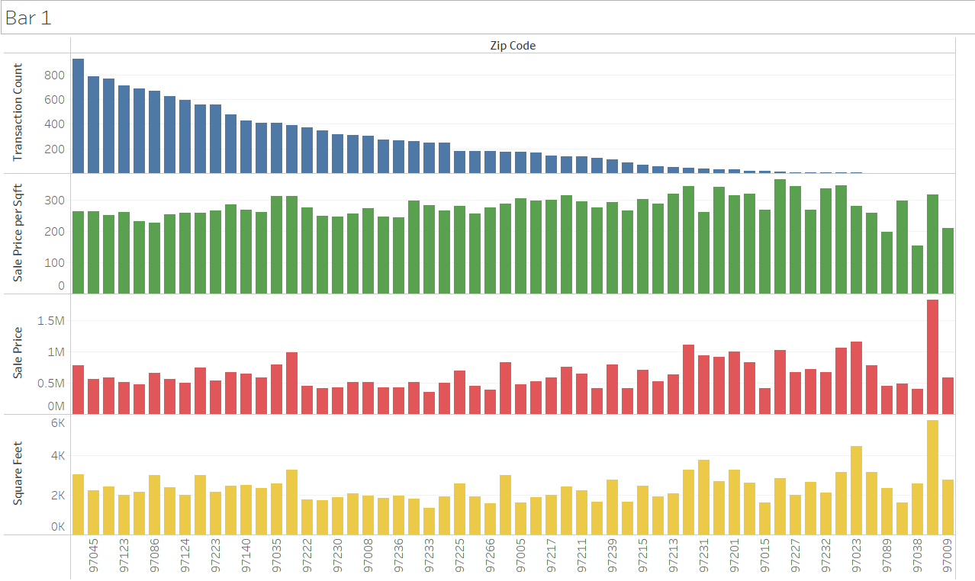
Comparison Bar Chart (Transactions, Sales Price per sqft, Sale Price, and Square Feet)
This bar chart is sorter by transaction count per zip code from high to low and also shows Sale Price in $ and per Sqft and Square Feet. There are a few facts and outliers interesting to note: (1) there does not seem to be any noticeable pattern between count of transactions and any of the other variables (2) we are highlighting some of the outliers that you can also notice in the map, these are areas with very low transaction count but very large and pricey homes.
Outlier

Slide 7
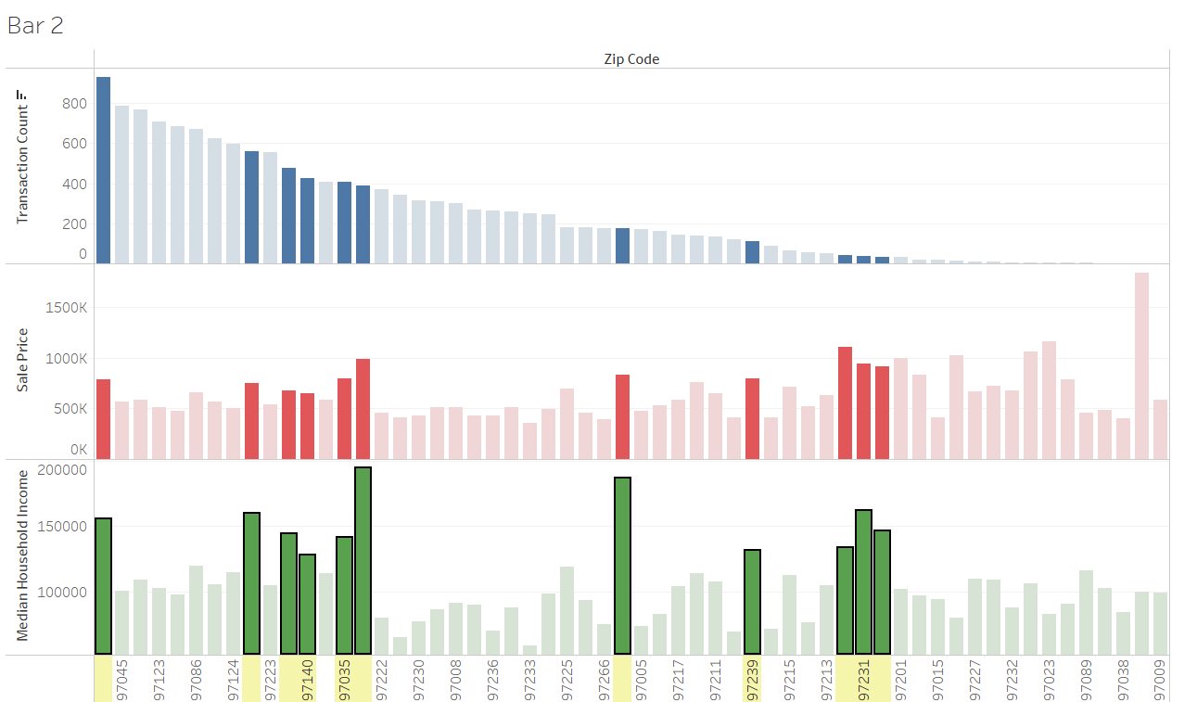
Comparison Bar Chart (Transactions, Sales Price and Median Household Income)
This bar chart is sorted by transaction count per zip code from high to low and also shows Sale Price in $ and Median Household Income. You can see that as highlighted below some of the higher income areas tend to have higher sale prices but not necessarily the case across the board as also show for example by the outlier shown below in which we see the highest sale price zip code but not necessarily coming from one of the highest income areas.
Outlier

Slide 8
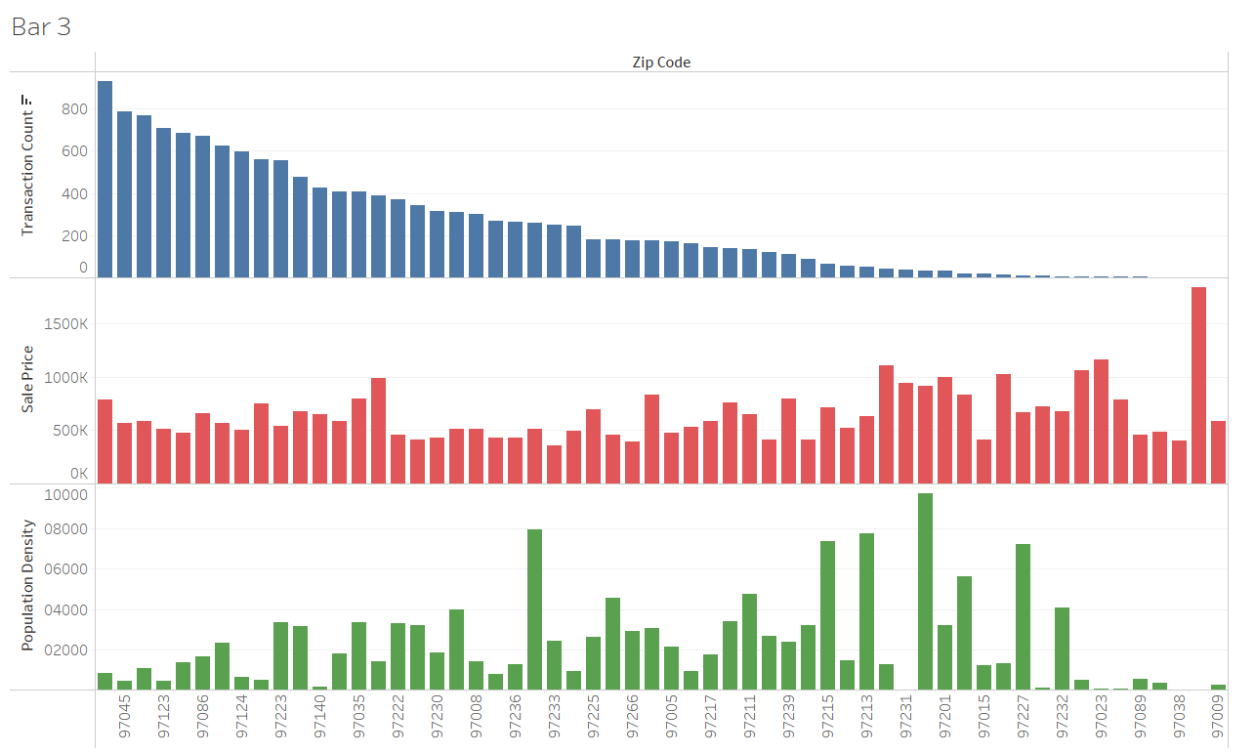
Comparison Bar Chart (Transactions, Sales Price and Medium Hosehold Income)
This bar chart is sorted by transaction count per zip code from high to low and also shows Sale Price in $ and Population Density. You can see below there is no obvious correlation between the number of transactions , the desinsity of the area and sale price. There is no necessarily a higher transaction count in more dense areas as one would expect. Or a higher sale price either.

Slide 9
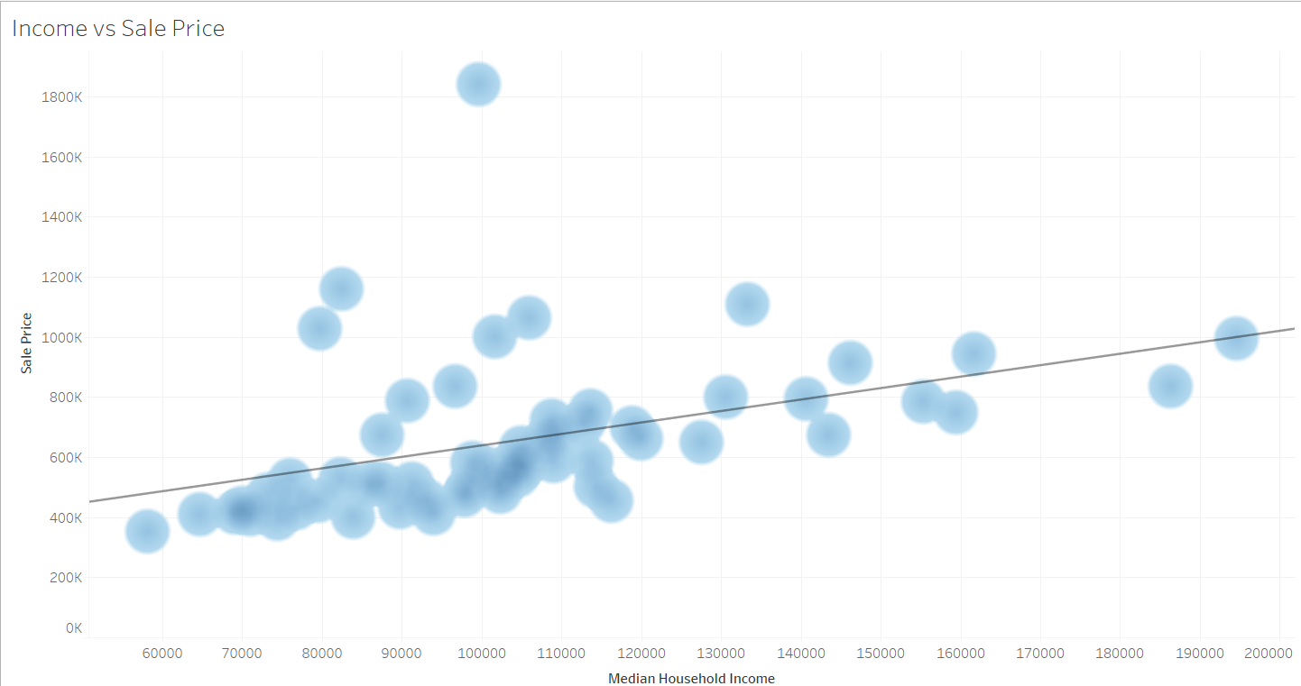
Relationship between Income and Sale Price
The scatter plot below show that there is some tendency to have higher price points in higher income areas but there are also some significant outliers. Given this the R square of the linear regression is only 0.18

Slide 10
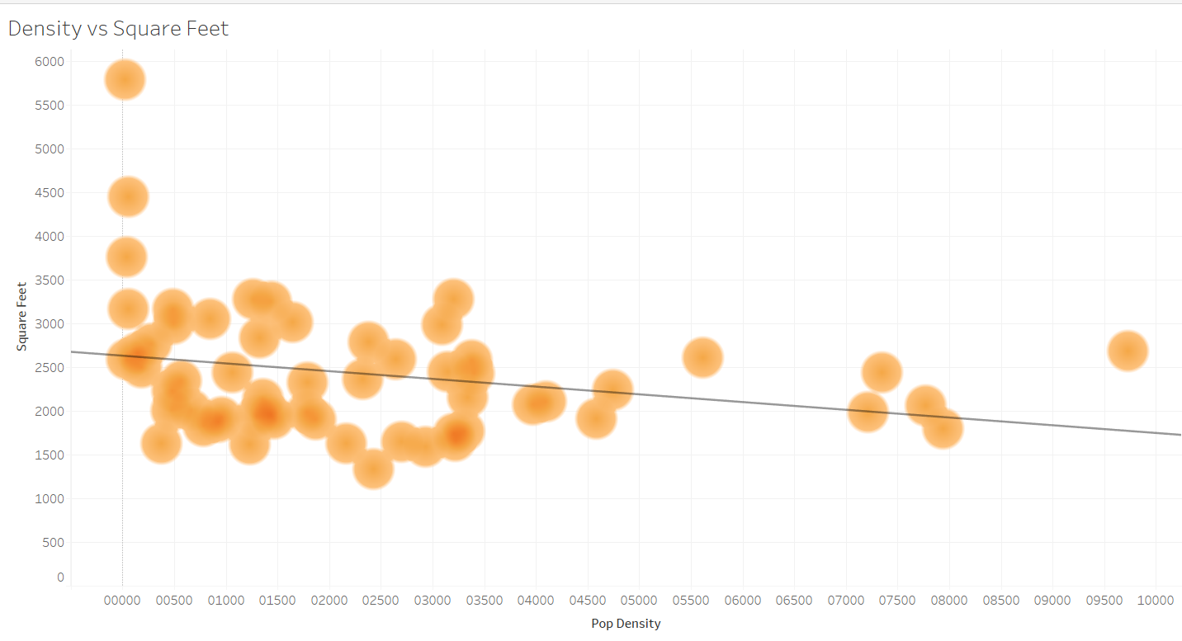
Relationship between Population Density and Square Feet
The scatter plot below show that there is some relationship between these two variable, though much lower than one would expect with an R square of only 0.07

